Slide 1
CHAPTER 8
Index Models

Slide 2
Advantages of the Single Index Model
Reduces the number of inputs for diversification
Easier for security analysts to specialize

Slide 3
Single Factor Model
β_{i} = response of an individual security’s return to the common factor, m. Beta measures systematic risk.
m = a common macroeconomic factor that affects all security returns. The S&P 500 is often used as a proxy for m.
e_{i} = firm-specific surprises

Slide 4
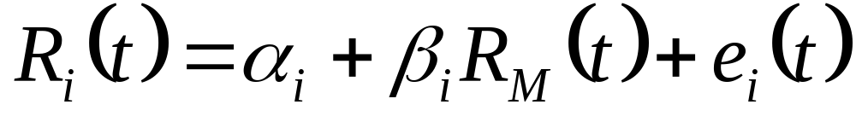
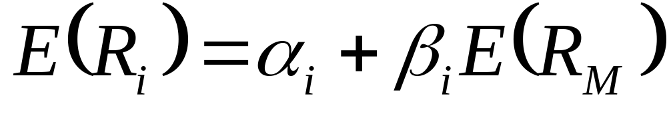
Single-Index Model
Regression Equation:
Expected return-beta relationship:

Slide 5
Single-Index Model
Risk and covariance:
  Variance = Systematic risk and Firm-specific risk:
  Covariance = product of betas x market index risk:

Slide 6
Single-Index Model
  Correlation = product of correlations with the market index

Slide 7
Index Model and Diversification
Variance of the equally weighted portfolio of firm-specific components:
When n gets large, σ²(e_{p}) becomes negligible and firm specific risk is diversified away.

Slide 8
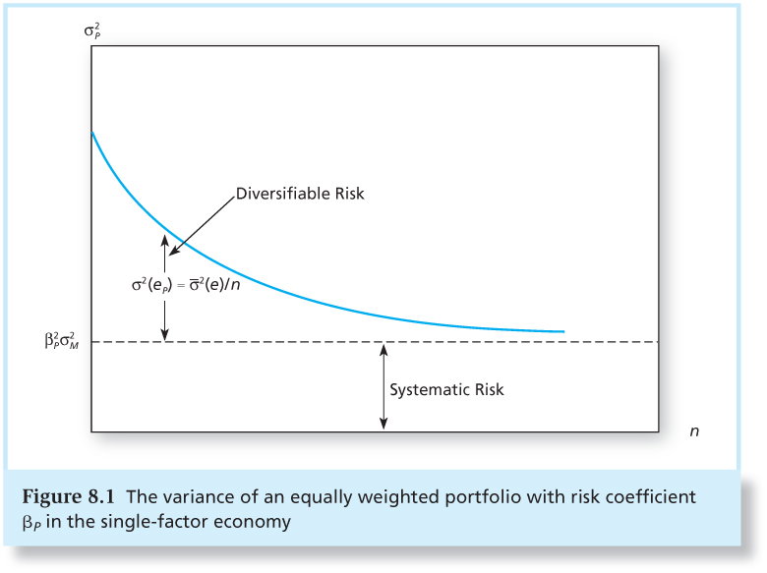
Figure 8.1 The Variance of an Equally Weighted Portfolio with Risk Coefficient β_{p}

Slide 9
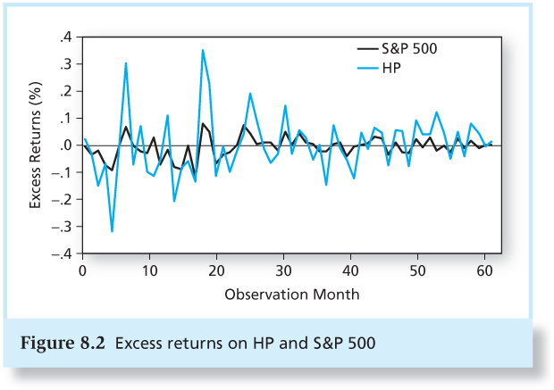
Figure 8.2 Excess Returns on HP and
S&P 500

Slide 10
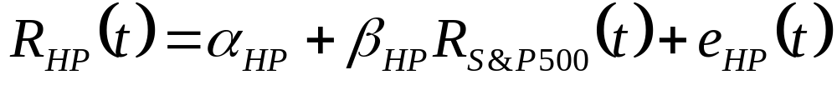
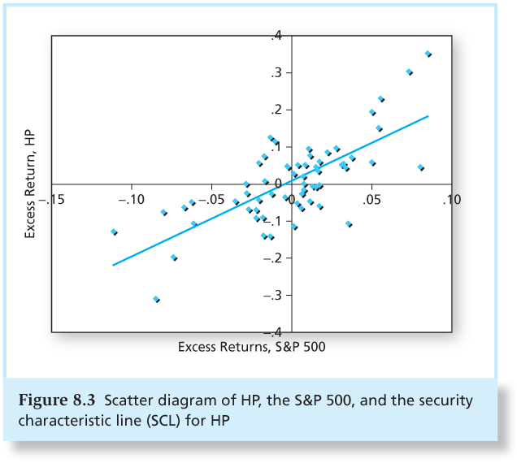
Figure 8.3 Scatter Diagram of HP, the S&P 500, and HP’s Security Characteristic Line (SCL)

Slide 11
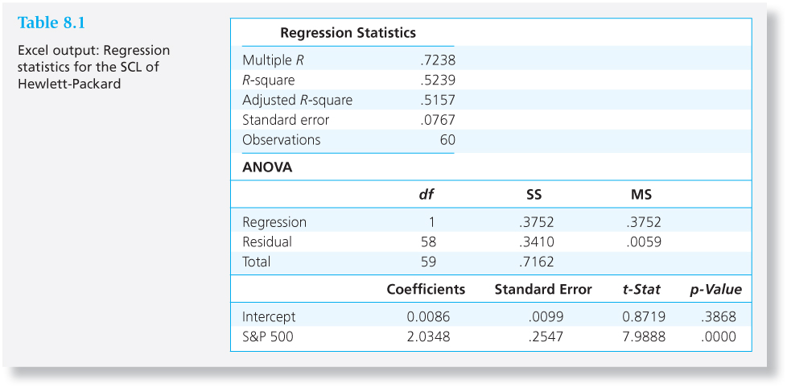
Table 8.1 Excel Output: Regression Statistics for the SCL of Hewlett-Packard

Slide 12
Table 8.1 Interpretation
Correlation of HP with the S&P 500 is 0.7238.
The model explains about 52% of the variation in HP.
HP’s alpha is 0.86% per month(10.32% annually) but it is not statistically significant.
HP’s beta is 2.0348, but the 95% confidence interval is 1.43 to 2.53.

Slide 13
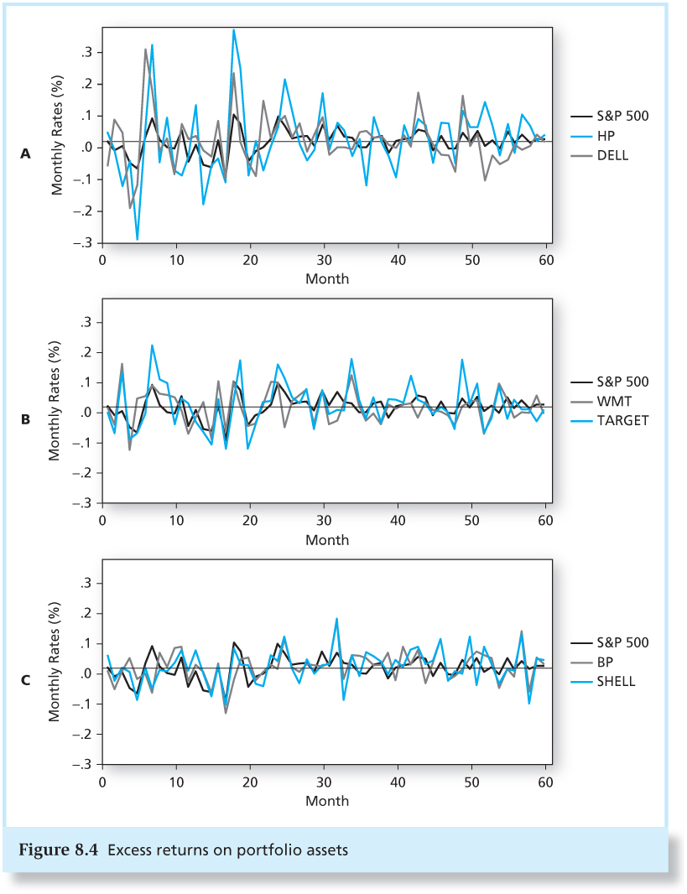
Figure 8.4 Excess Returns on Portfolio Assets

Slide 14
Alpha and Security Analysis
Use macroeconomic analysis to estimate the risk premium and risk of the market index.
Use statistical analysis to estimate the beta coefficients of all securities and their residual variances, σ₂ (e_{i}).

Slide 15
Alpha and Security Analysis
Establish the expected return of each security absent any contribution from security analysis.
Use security analysis to develop private forecasts of the expected returns for each security.

Slide 16
Single-Index Model Input List
Risk premium on the S&P 500 portfolio
Estimate of the SD of the S&P 500 portfolio
n sets of estimates of
  Beta coefficient
  Stock residual variances
  Alpha values

Slide 17
Optimal Risky Portfolio of the
Single-Index Model
Maximize the Sharpe ratio
  Expected return, SD, and Sharpe ratio:

Slide 18
Optimal Risky Portfolio of the
Single-Index Model
Combination of:
  Active portfolio denoted by A
  Market-index portfolio, the passive portfolio denoted by M

Slide 19
Optimal Risky Portfolio of the
Single-Index Model
  Modification of active portfolio position:
  When

Slide 20
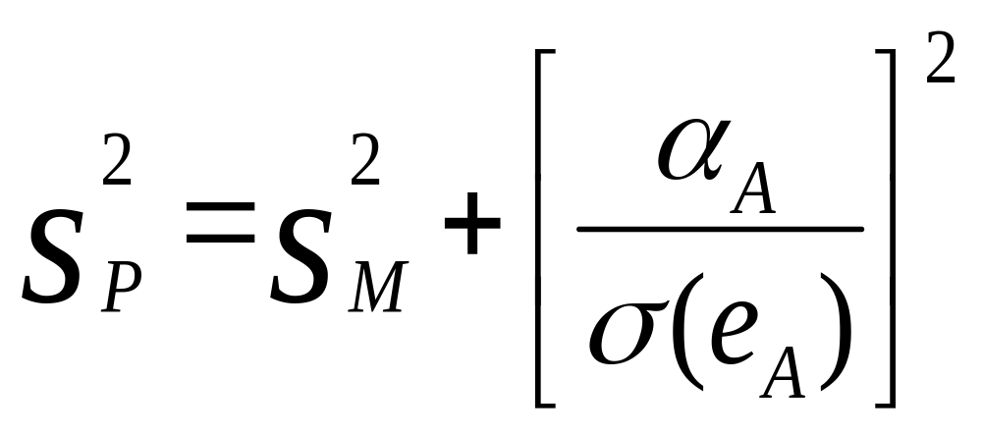
The Information Ratio
The Sharpe ratio of an optimally constructed risky portfolio will exceed that of the index portfolio (the passive strategy):

Slide 21
The Information Ratio
The contribution of the active portfolio depends on the ratio of its alpha to its residual standard deviation.
The information ratio measures the extra return we can obtain from security analysis.

Slide 22
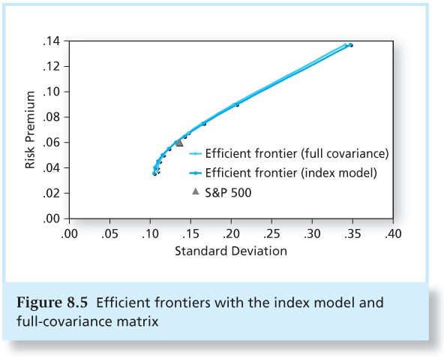
Figure 8.5 Efficient Frontiers with the Index Model and Full-Covariance Matrix

Slide 23
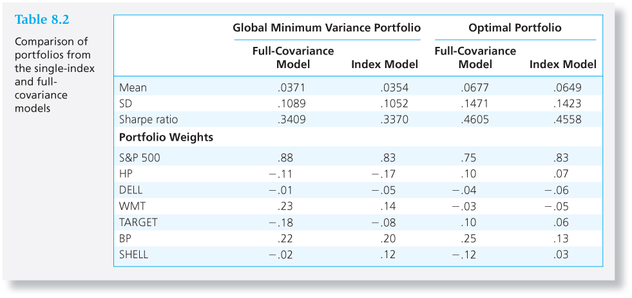
Table 8.2 Portfolios from the Single-Index and Full-Covariance Models

Slide 24
Is the Index Model Inferior to the
Full-Covariance Model?
Full Markowitz model may be better in principle, but
  Using the full-covariance matrix invokes estimation risk of thousands of terms.
  Cumulative errors may result in a portfolio that is actually inferior to that derived from the single-index model.
  The single-index model is practical and decentralizes macro and security analysis.

Slide 25
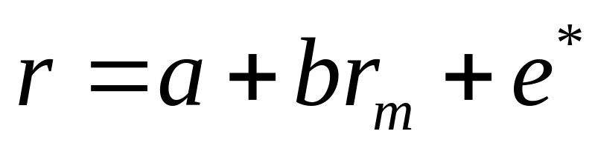
Beta Book: Industry Version of the Index Model
Use 60 most recent months of price data
Use S&P 500 as proxy for M
Compute total returns that ignore dividends
Estimate index model without excess returns:

Slide 26
Beta Book: Industry Version of the Index Model
Adjust beta because:
The average beta over all securities is 1. Thus, our best forecast of the beta would be that it is 1.
Also, firms may become more “typical” as they age, causing their betas to approach 1.

Slide 27
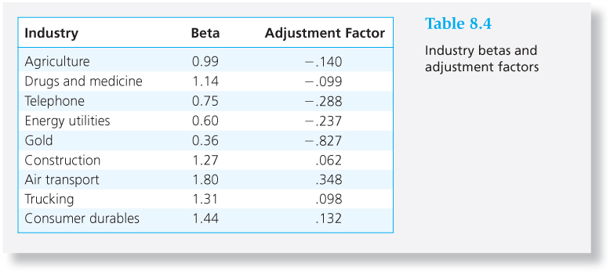
Table 8.4 Industry Betas and Adjustment Factors

